Slide 1
Power BI
Task – 4
Elevate labs

Slide 2
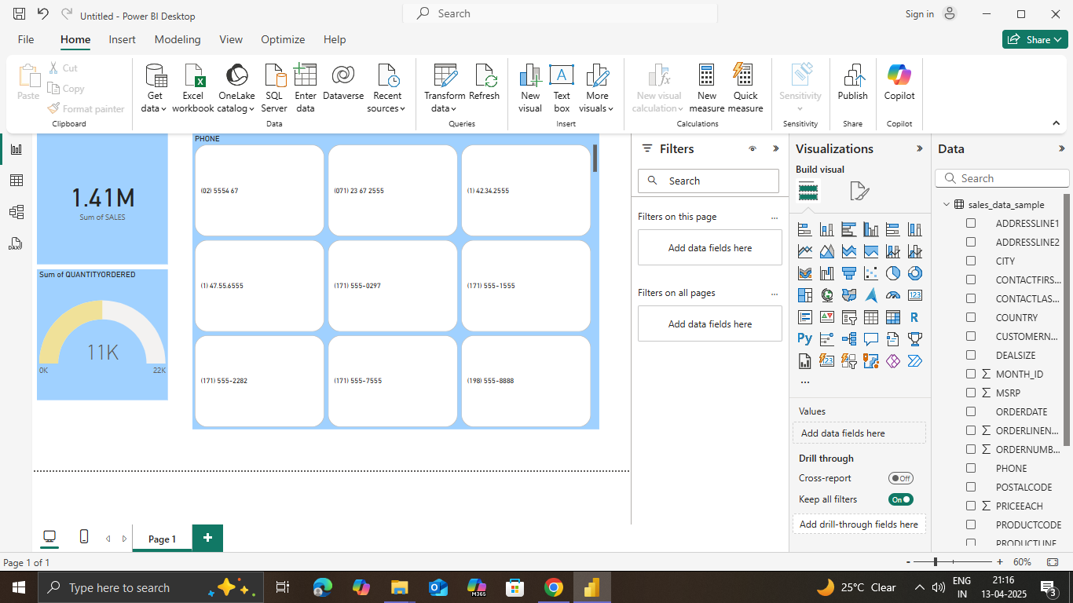
Visualizations of my dataset

Slide 3
KPI (Key Performance Indicator)
Highlights critical metrics like revenue, profit margin, or sales growth with visual indicators (e.g., green for target met, red for underperformance).

Slide 4
Slicers:
Interactive buttons that let users filter data easily by categories like region, product, or sales rep for focused insights.

Slide 5
Filters:
Enable detailed, backend-level filtering (e.g., filter by year, product type) to refine visuals without cluttering the UI.

Slide 6
Time Series Analysis:
Visualizes trends over time (monthly revenue, yearly growth, etc.), helping track performance and forecast future outcomes.

Slide 7
Cards:
Display key financial figures (total sales, expenses, profit) in a clean, compact format for quick glances.

Slide 8
Light Blue Color Theme:
A calming and professional aesthetic that enhances readability while aligning with corporate visuals—used in charts, backgrounds, and highlights.

